Slide 1
Notes:
As we said at the beginning the speed of tech is so fast that its hard to keep up – the race to make money, be the first, change the way that people behave is ever faster, more complex and more filled with risk confusion, complexity and conflict..
So – there is a real need and focus on making technology work for people – because after all we are all in the same boat – we push and pull tech, messaging, marketing etc

Slide 2
Hey

Slide 3
I am …………………………

Slide 4
A Husband. Father. Son

Slide 5
Anxious. Nervous. Confident.

Slide 6
I Laugh. Cry. Scream. Shout

Slide 7
I learn and I teach

Slide 8
I inspire and am inspired.

Slide 9
I am ignorant and aware.

Slide 10
Just like you.

Slide 11
I am not….

Slide 12
An algorithm.

Slide 13
A line in a database.

Slide 14
A trend.

Slide 15
I am definately not a brand.

Slide 16
I’m not a robot.

Slide 17
I’m not a user, in a segment, a demographic or a target audience.

Slide 18
I’m a human.
Notes:
So, some boring stuff about my background and why humane tech is important to me as opposed to the work I’ve done in the past.
Work with 6 agencies – all focused on doing stuff right…
Advisor to two start ups.
Ex Director of an agency or two.
Ghost write and author articles
Mental Health Charity trustee.
Just finished my Open Uni degree in Computer and Behavioural Science and now learning Spanish before looking to do a masters in philosophy.
Slightly overly Independent consultant.
And I hope over the next 30 mins you’ll find out a little more about me and maybe I about you.

Slide 19
This is a digital world.

Slide 20
I connect to digital but I am analogue.
Notes:
And I hope over the next 30 mins you’ll find out a little more about me and maybe I about you.

Slide 21
Making a digital to human connection is the core focus of our work as digital professionals.

Slide 22
Human;
“a member of the genus Homo — specifically the species Sapiens” and “a person”.
Notes:
Maybe we are always ‘on’ – potentially much to our longer term detriment (for another discussion).

Slide 23
Digital;
“Involving or relating to the use of computer technology”.

Slide 24
Connection;
“the state of being connected”. Two parts are in a state of connection.

Slide 25
So, a human and digital connection is;
Putting a person and computer technology in the same state.

Slide 26
So, it follows that digital is a way to show more humanity – not less.

Slide 27
That’s why I’m here and I hope you are too.

Slide 28
Let’s talk
Design and digital for good.
Why you should ignore the tech.
Why having core ethics will deliver the future.
What does a market that is always changing look for?
What to do.
What not to do.
Don’t believe me - believe these people.

Slide 29
Digital needs you. Humanity needs you.

Slide 30
Digital needs ethicists
Initial intent of technology may be good. Ultimate outcomes may be negative. (Twitter, FB etc.)
GDPR will continue to have a huge impact on privacy - as it should.
How can you market effectively without collecting loads of data from customers?
How can we stop new tech turning into the modern web (non-stop pop up’s etc.)?
How are you going to change your strategies when an individual’s data becomes their currency?

Slide 31
Digital needs ethicists
Think of the impact of your decisions and designs on people, not on share price and KPI’s.
Corporate organisations here today will fail. If they have a digital transformation project it’s too late.
You guys will be the change for good.

Slide 32
Business needs you. Humanity needs you.

Slide 33
A lot of noise in tech…..
Artificial Intelligence
Machine Learning
Voice Interactions
Bots
Virtual Reality and Augmented Reality
Blockchain

Slide 34
Are you ready for your future?

Slide 35
You think that was nuts?

Slide 36
But remember not to get distracted by the tech…
Notes:
This is a comment from

Slide 37
“Not heard much about blockchain, voice UI or chatbots for a bit – a lull in the insanity…”
Tom Goodwin – Head of Digital and Innovation - Zenith Media.
Notes:
This is a comment from

Slide 38
“….be nice to use this gap to just make better/more simple products, experiences and campaigns, with stronger ideas behind them. “
Tom Goodwin – Head of Digital and Innovation - Zenith Media.

Slide 39
What’s gone wrong in the past.
We’ve let you down..you need to clear up our mess.
Notes:
Macro and Micro.

Slide 40
Facebook and Cambridge Analytica
Its impact is greater than GDPR.
May take years but trust is broken.
The Surveillance Economy will start to fragment
GAFA will be no more.
What is the effect in the short-term?
Personalisation will become less important for individuals – but a personal level of privacy more so.
Business will have ‘less to go on’ in terms of what individuals are doing.
New tech will be truly user focused.
Notes:
This will change the digital and tech space forever. About 3 years ago I wrote about this happening and because if you recall I avoid responsibility I didn’t push hard enough – anyway – here we are.
Surveillance Economy? Facebook and Google make their money from your data. They watch you, gather information and sell it to advertisers or development houses.
Google will be next.
Apple will stay away from it – because they provide hardware and will rise above the noise… they give you music. TV. Etc. Google and FB have fallen behind that. They will do one of two things – build more tech or spend serious money getting into content. i.e. movies and sport..
Amazon are away and gone in the longer term. They produce content. Host most of the web and sell stuff for everyone to everyone.

Slide 41
We play tricks on people..

Slide 42
We treat them as fools..

Slide 43
We treat empathy and authenticity as a commodity

Slide 44
We don’t care……
Notes:
Ladies and Gentlemen. The Economist – the way it was… an example of taking a technology and applying it to old school thinking – a complete and utter disregard for consumers and in one simple stroke the entire power and potential of AI is missed…..

Slide 45
But there is some sense….
Things are changing
Notes:
Macro and Micro.

Slide 46
We stand by our principles..

Slide 47
We highlight behaviour…

Slide 48
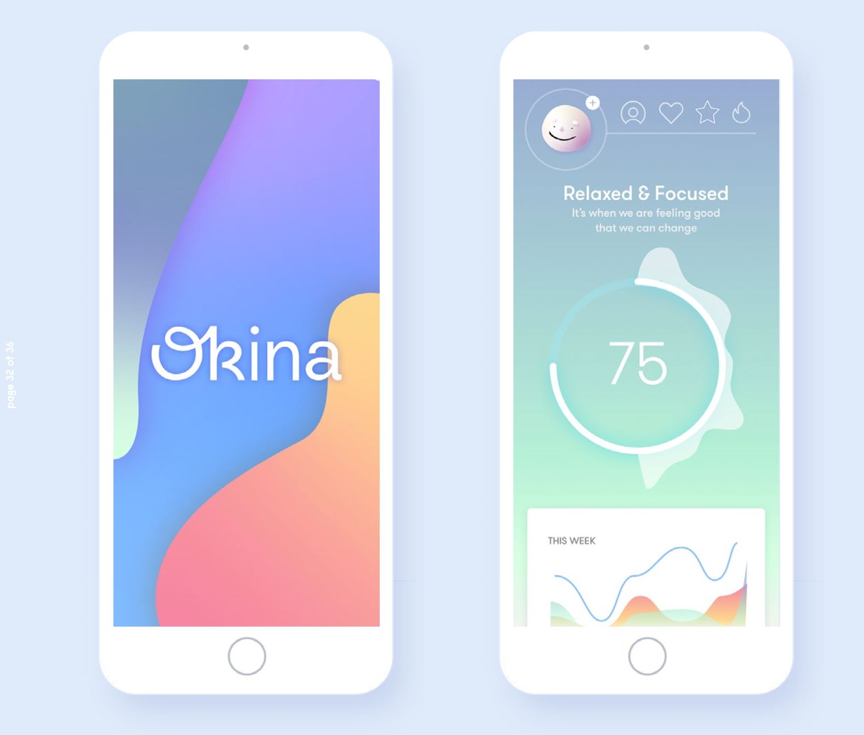
We develop new thinking
meet okina.
Your very own intelligent wellness companion.
Measures how you feel without lengthy surveys
Identifies burnout risk
Recommends the right conditions and working habits to be your best
A bit like a Fitbit. But for mental wellness
Notes:
Meet okina. We have brought together the latest technology and behavioural science to develop an intelligent mental wellness application to measure, track and your mental wellness at work. A bit like a fitbit but for mental wellness.

Slide 49
We create new economies…

Slide 51
What is an ever changing marketing looking for?
How to stand out.

Slide 52
What to think about.
Be ethical.
Be a generalist. Understand the grey between skillsets.
Don’t let employers put you in a box. Boxes are commodities and we flatten and then throw boxes away. Don’t get flattened.
How can your designs, your ideas really make a difference to people’s lives? Put these in context.
Remember you drive the future – be confident in your own understanding of what you want to see.

Slide 53
How to stand out.
Project how you see the future to people.
Make that human connection in your work.
Understand and articulate the balance of efficiency and excellence in your work.
Be ready to do something completely different when you want.
Constantly educate yourself.
Be brave. Listen and learn from this university and these experts. Then do your own thing.
The industry needs new thinkers. Clients demand a new way. Humans are tired, sceptical and bored.
Notes:
Get off the Bournemouth treadmill. You will not change the world from here.

Slide 54
Oh – and look people in the eye when you firmly shake hands with them.

Slide 55
How to blend into the background
Add to the noise, content, opinion, lies, truths etc…
Be safe.
Constrain yourself.
Settle for a business that does not share your belief in tech and digital for good.
Follow the herd on LinkedIn.
Believe that you have to conform to the existing market conditions.
Don’t ground yourself in the core basics of your craft.

Slide 56
Read, watch and listen to these.
Tom Goodwin.
Jaron Lanier.
Faris Yakoub.
Scott Galloway.
Tristan Harris.
Cennydd Bowles
Listen to those with the quietest voices. They are the best thinkers.

Slide 57
Notes:
I’d like to leave you with this…
As we said at the beginning the speed of tech is so fast that its hard to keep up – the race to make money, be the first, change the way that people behave is ever faster, more complex and more filled with risk confusion, complexity and conflict..
So – there is a real need and focus on making technology work for people – because after all we are all in the same boat – we push and pull tech, messaging, marketing etc

